Slide 1
Introduction
Chapter 1

Slide 2
TCP/IP Reference Model

Slide 3
Why Another Model?
Although the OSI reference model is universally recognized, the historical and technical open standard of the Internet is Transmission Control Protocol / Internet Protocol (TCP/IP).
The TCP/IP reference model and the TCP/IP protocol stack make data communication possible between any two computers, anywhere in the world, at nearly the speed of light.
The U.S. Department of Defense (DoD) created the TCP/IP reference model because it wanted a network that could survive any conditions, even a nuclear war.

Slide 4
Don’t Confuse the Models
The OSI Model
The TCP/IP Model
7 Application
Application
LAYER
6 Presentation
5 Session
4 Transport
Transport LAYER
3 Network
Internet LAYER
2 Data Link
Network Access LAYER
1 Physical

Slide 5
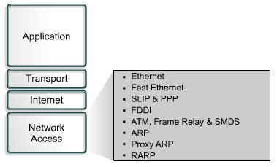
The Network Access Layer
The network access layer is also called the host-to-network layer. It the layer that is concerned with all of the issues that an IP packet requires to actually make a physical link to the network media. It includes LAN and WAN details, and all the details contained in the OSI physical and data-link layers. NOTE: ARP & RARP work at both the Internet and Network Access Layers.

Slide 6
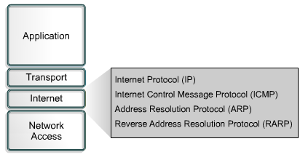
The Internet Layer
The purpose of the Internet layer is to select the best path through the network for packets to travel. The main protocol that functions at this layer is the Internet Protocol (IP). Best path determination and packet switching occur at this layer.

Slide 7
The TCP/IP Reference Model
The ability to connect multiple networks in a seamless way known as the TCP/IP Reference Model, the name came from its two primary protocols (TCP and IP protocols).
The Internet Layer :
The internet layer is a connectionless internetwork layer. Its job is to permit hosts to inject packets into any network and have them travel independently to the destination (potentially on a different network). They may even arrive in a different order than they were sent, in which case it is the job of higher layers to rearrange them, if in-order delivery is desired. The internet layer defines an official packet format and protocol called IP (Internet Protocol). The job of the internet layer is to deliver IP packets where they are supposed to go. Packet routing is clearly the major issue here, as is avoiding congestion. For these reasons, it is reasonable to say that the TCP/IP internet layer is similar in functionality to the OSI network layer. The following figure shows this correspondence.

Slide 8
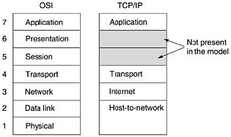

Slide 9
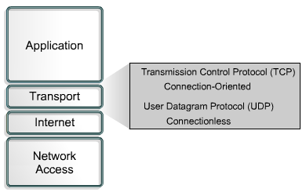
The Transport Layer
The transport layer provides transport services from the source host to the destination host. It constitutes a logical connection between these endpoints of the network. Transport protocols segment and reassemble upper-layer applications into the same data stream between endpoints.
The transport layer data stream provides end-to-end transport services.

Slide 10
The Transport Layer
The layer above the internet layer in the TCP/IP model is called the transport layer. It is designed to allow peer entities on the source and destination hosts to carry on a conversation, just as in the OSI transport layer. Two end-to-end transport protocols have been defined here. The first one, TCP (Transmission Control Protocol), is a reliable connection-oriented protocol that allows a byte stream originating on one machine to be delivered without error on any other machine in the internet. It fragments the incoming byte stream into discrete messages and passes each one on to the internet layer. At the destination, the receiving TCP process reassembles the received messages into the output stream. TCP also handles flow control to make sure a fast sender cannot swamp a slow receiver with more messages than it can handle.

Slide 11
TCP
Transmission Control Protocol (TCP) is a connection-oriented Layer 4 protocol that provides reliable full-duplex data transmission.
TCP is part of the TCP/IP protocol stack. In a connection-oriented environment, a connection is established between both ends before the transfer of information can begin.
TCP is responsible for breaking messages into segments, reassembling them at the destination station, resending anything that is not received, and reassembling messages from the segments.TCP supplies a virtual circuit between end-user applications.
The protocols that use TCP include:
FTP (File Transfer Protocol)
HTTP (Hypertext Transfer Protocol)
SMTP (Simple Mail Transfer Protocol)
Telnet

Slide 12
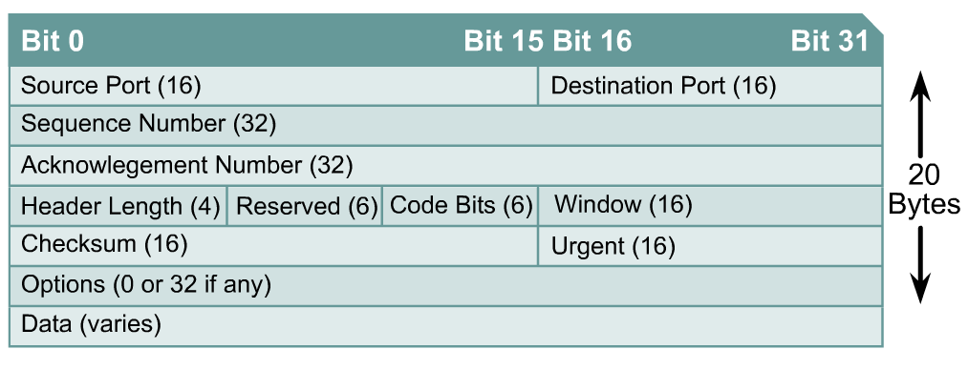
TCP Segment Format

Slide 13
The second protocol in this layer, UDP (User Datagram Protocol), is an unreliable, connectionless protocol for applications that do not want TCP's sequencing or flow control and wish to provide their own. It is also widely used for one-shot, client-server-type request-reply queries and applications in which prompt delivery is more important than accurate delivery, such as transmitting speech or video. The relation of IP, TCP, and UDP is shown in the following figure. Since the model was developed, IP has been implemented on many other networks.

Slide 14
UDP
User Datagram Protocol (UDP) is the connectionless transport protocol in the TCP/IP protocol stack.
UDP is a simple protocol that exchanges datagrams, without acknowledgments or guaranteed delivery. Error processing and retransmission must be handled by higher layer protocols.
UDP uses no windowing or acknowledgments so reliability, if needed, is provided by application layer protocols. UDP is designed for applications that do not need to put sequences of segments together.
The protocols that use UDP include:
TFTP (Trivial File Transfer Protocol)
SNMP (Simple Network Management Protocol)
DHCP (Dynamic Host Control Protocol)
DNS (Domain Name System)

Slide 15

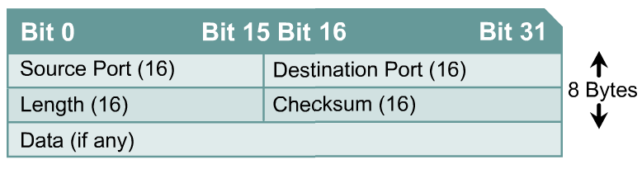
UDP Segment Format

Slide 16
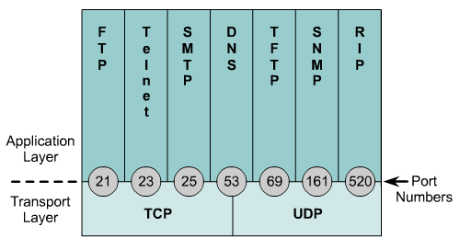
Well Known Port Numbers
The following port numbers should be memorized:
NOTE:
The curriculum forgot to mention one of the most important port numbers.
Port 80 is used for HTTP or WWW protocols. (Essentially access to the internet.)

Slide 17
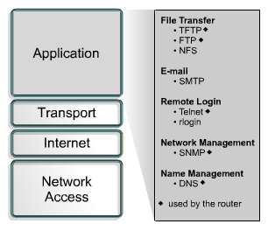
The Application Layer
The application layer of the TCP/IP model handles high-level protocols, issues of representation, encoding, and dialog control.

Slide 18
The Application Layer
The TCP/IP model does not have session or presentation layers. On top of the transport layer is the application layer. It contains all the higher-level protocols. The early ones included virtual terminal (TELNET), file transfer (FTP), and electronic mail (SMTP). The virtual terminal protocol allows a user on one machine to log onto a distant machine and work there. The file transfer protocol provides a way to move data efficiently from one machine to another. Electronic mail was originally just a kind of file transfer, but later a specialized protocol (SMTP) was developed for it. Many other protocols have been added to these over the years: the Domain Name System (DNS) for mapping host names onto their network addresses, NNTP, the protocol for moving USENET news articles around, and HTTP, the protocol for fetching pages on the World Wide Web, and many others.
. The Host-to-Network Layer
The host has to connect to the network using some protocol so it can send IP packets to it. This protocol is not defined and varies from host to host and network to network.

Slide 19
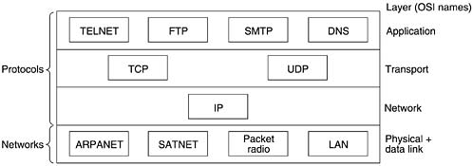
Protocols and networks in the TCP/IP model.

Slide 20
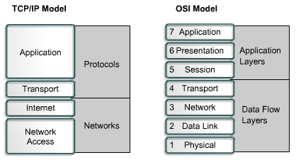
Comparing TCP/IP & OSI Models
NOTE: TCP/IP transport layer using UDP does not always guarantee reliable delivery of packets as the transport layer in the OSI model does.

Slide 21

Chapter 19
Network Layer:
Logical Addressing
Copyright © The McGraw-Hill Companies, Inc. Permission required for reproduction or display.

Slide 22
19-1 IPv4 ADDRESSES
An IPv4 address is a 32-bit address that uniquely and universally defines the connection of a device (for example, a computer or a router) to the Internet.
Topics discussed in this section:
Address Space Notations
Classful Addressing
Classless Addressing
Network Address Translation (NAT)

Slide 23

Note
An IPv4 address is 32 bits long.

Slide 24
Note
The IPv4 addresses are unique and universal.

Slide 25
Note
The address space of IPv4 is 2³² or 4,294,967,296.

Slide 26
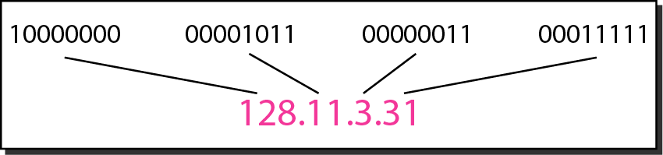
Figure 19.1 Dotted-decimal notation and binary notation for an IPv4 address

Slide 27
Example 19.1
Change the following IPv4 addresses from binary notation to dotted-decimal notation.
Solution
We replace each group of 8 bits with its equivalent decimal number (see Appendix B) and add dots for separation.

Slide 28
Example 19.2
Change the following IPv4 addresses from dotted-decimal notation to binary notation.
Solution
We replace each decimal number with its binary equivalent (see Appendix B).

Slide 29
Example 19.3
Find the error, if any, in the following IPv4 addresses.
Solution
a. There must be no leading zero (045).
b. There can be no more than four numbers.
c. Each number needs to be less than or equal to 255.
d. A mixture of binary notation and dotted-decimal notation is not allowed.

Slide 30
Note
In classful addressing, the address space is divided into five classes:
A, B, C, D, and E.

Slide 31
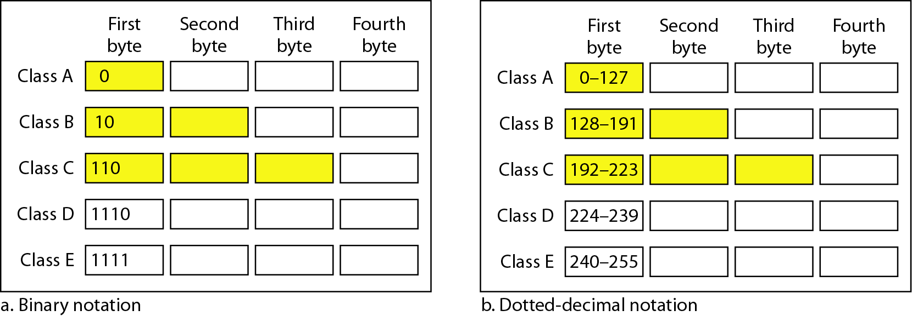
Figure 19.2 Finding the classes in binary and dotted-decimal notation

Slide 32
Example 19.4
Find the class of each address.
a. 00000001 00001011 00001011 11101111
b. 11000001 10000011 00011011 11111111
c. 14.23.120.8
d. 252.5.15.111
Solution
a. The first bit is 0. This is a class A address.
b. The first 2 bits are 1; the third bit is 0. This is a class C address.
c. The first byte is 14; the class is A.
d. The first byte is 252; the class is E.

Slide 33
Table 19.1 Number of blocks and block size in classful IPv4 addressing

Slide 34
Note
In classful addressing, a large part of the available addresses were wasted.

Slide 35
Table 19.2 Default masks for classful addressing

Slide 36
Note
Classful addressing, which is almost obsolete, is replaced with classless addressing.

Slide 37
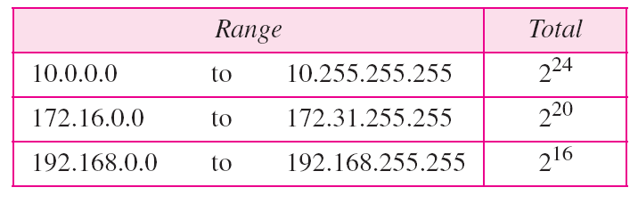
Table 19.3 Addresses for private networks

Slide 38
19-2 IPv6 ADDRESSES
Despite all short-term solutions, address depletion is still a long-term problem for the Internet. This and other problems in the IP protocol itself have been the motivation for IPv6.
Topics discussed in this section:
Structure Address Space

Slide 39
Note
An IPv6 address is 128 bits long.

Slide 40
Subnetting Basics

Slide 41
Why does a computer need a subnet mask?
Subnet mask looks like IP address
It is 32 bits long, the same length as IPv4 address, but they are different.
Subnet mask in binary is a string of ones followed by some number of zeroes.

Slide 42
Subnetting
You were only defining one network. What happens if you wanted to take one network address and create six networks from it? You would have to do something called subnetting , because that’s what allows you to take one larger network and break it into a bunch of smaller networks.

Slide 43
Why we need Subnetting?
Reduced network traffic
Optimized network performance
Simplified management

Slide 44
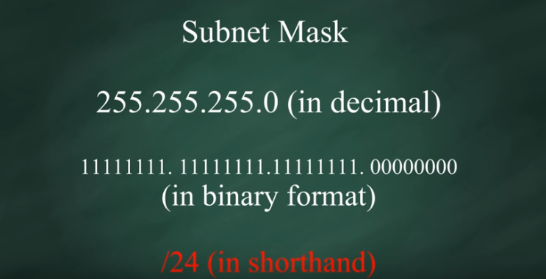

Slide 45
Table 19.2 Default masks for classful addressing

Slide 46
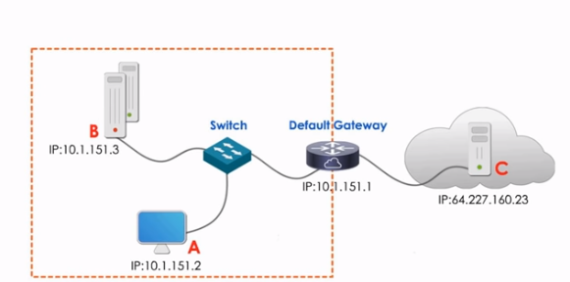
Locally and remotely communication Network ID is an unique identifier for LAN Since both computers A and B share the same network ID Subnet Mask is used by a computer to determine if another computer is on the same network or on a different network (the location or same network or different network). Computer A uses its subnet mask to find out that Computer B is local and computer C is remote MAC address is used for local communication, and IP is used for Remote communication (ARP)

Slide 47
Classless Inter-Domain Routing (CIDR)

Slide 49
How to Create Subnets
To create subnetworks, you take bits from the host portion of the IP address and reserve them to define the subnet address. This means fewer bits for hosts, so the more subnets, the fewer bits available for defining hosts.

Slide 50
How to Create Subnets…
Follow these steps:
Determine the number of required network IDs:
Determine the number of required host IDs per subnet:
Based on the above requirements, create the following:
One subnet mask for your entire network
A unique subnet ID for each physical segment
A range of host IDs for each subnet

Slide 51
Subnet Masks
For the subnet address scheme to work, every machine on the network must know which part of the host address will be used as the subnet address. This is accomplished by assigning a Subnet mask
For each machine. A subnet mask is a 32-bit value that allows the recipient of IP packets to distinguish the network ID portion of the IP address from the host ID portion of the IP address.

Slide 52
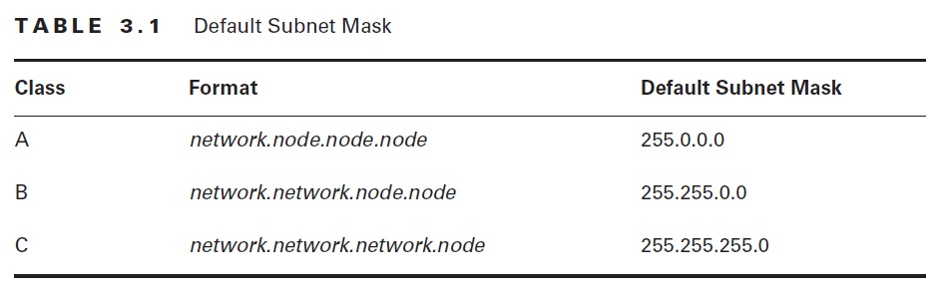
Subnet Masks

Slide 53
Classless Inter-Domain Routing (CIDR)
It’s basically the method that ISPs (Internet Service Providers) use to allocate an amount of addresses to a company, a home—a customer. They provide addresses in a certain block size,

Slide 54
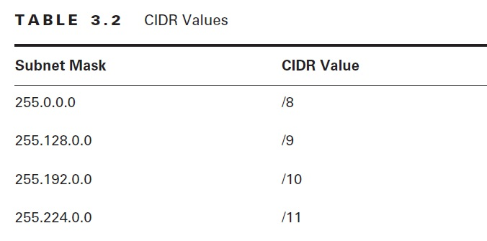
Classless Inter-Domain Routing (CIDR)

Slide 55
Subnetting Class C Addresses
The Fast Way: all you need to do is answer five simple questions:
How many subnets does the chosen subnet mask produce?
How many valid hosts per subnet are available?
What are the valid subnets?
What’s the broadcast address of each subnet?
What are the valid hosts in each subnet?

Slide 56
Subnetting Class C Addresses
How many subnets? 2^{x} -2 = number of subnets. x is the number of masked bits, or the 1s. For example, in 11000000, the number of ones gives us 2² subnets. In this example, there are 4 subnets.
How many hosts per subnet? 2^{y} -2 = number of hosts per subnet. y is the number of unmasked bits, or the 0s. For example, in 11000000, the number of zeros gives us 2⁶ hosts. In this example, there are 62 hosts per subnet. You need to subtract two for the subnet address and the broadcast address, which are not valid hosts.

Slide 57
Subnetting Class C Addresses
What are the valid subnets? 256 – subnet mask = block size. An example would be 256 – 192 = 64. The block size of a 192 mask is always 64.
Start counting at zero in blocks of 64 until you reach the subnet mask value and these are your subnets 0, 64, 128, 192.
What’s the broadcast address for each subnet? Since we counted our subnets in the last section as 0, 64, 128, and 192, the broadcast address is always the number right before the next subnet. For example, the 0 subnet has a broadcast address of 63 because the next subnet is 64. The 64 subnet has a broadcast address of 127 because the next subnet is 128, etc. And remember, the broadcast of the last subnet

Slide 58
Subnetting Class C Addresses
What are the valid hosts? Valid hosts are the numbers between the subnets, omitting all the 0s and all 1s. For example, if 64 is the subnet number and 127 is the broadcast address, then 65–126 is the valid host range—it’s always the numbers between the subnet address and the

Slide 59
Examples
Write the subnet, broadcast address, and valid host range for each of the following:
192.168.100.25/30
192.168.100.66/27
192.168.100.17/29

Slide 60
Classful
Class C
192.168.0.0 /24
255.255.255.0
11111111. 11111111. 11111111.00000000
Host 2^X - 2 = 2^8 – 2 = 256 – 2 = 254
X=>0
Network 2^Y = 2^0 = 1
Y=>1

Slide 61
192.168.0.0 | Net
192.168.0.1 | Frist host
192.168.0.254 | last host
192.168.0.255 | Broad cast

Slide 62
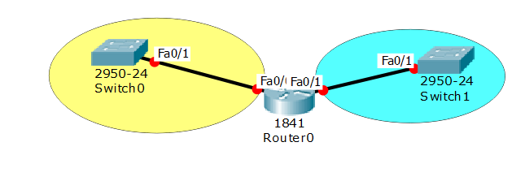
Classless
192.168.0.0

Slide 63
CIDR = Classless Inter-Domain Routing
192.168.0.0 /25
255.255.255.128
.00000000 → 10000000
Host 2^7-2 = 128 – 2 = 126
Net 2^1 = 2
❒ 256 – 128 = 128
192.168.0.128 | 192.168.0.0 | Net
192.168.0.129 | 192.168.0.1 | Frist host
192.168.0.254 | 192.168.0.126 | last host
192.168.0.255 | 192.168.0.127 | Broad cast

Slide 64
CIDR = Classless Inter-Domain Routing
192.168.0.0 /26
255.255.255.192
00000000 --→ 11000000
Host 2^6 - 2 = 64 – 2 = 62
Net 2^2 = 4
❒ 256 –192 = 64
192 | 128 | 64 | 0 | Net
193 | 129 | 65 | 1 | Frist host
254 | 190 | 126 | 62 | last host
255 | 191 | 127 | 63 | Broad cast

Slide 65
CIDR = Classless Inter-Domain Routing
192.168.0.0 /27
255.255.255.224
00000000 --→ 11100000
Host 2^5 - 2 = 32 – 2 = 30
Net 2^3 = 8
❒ 256 – 224 = 32
224 | 192 | 160 | 128 | 96 | 64 | 32 | 0 | Net
225 | 193 | 161 | 129 | 97 | 65 | 33 | 1 | Frist host
254 | 222 | 190 | 158 | 126 | 94 | 62 | 30 | last host
255 | 223 | 191 | 159 | 127 | 95 | 63 | 31 | Broad cast

Slide 66
CIDR = Classless Inter-Domain Routing
192.168.0.0 /28
255.255.255.240
00000000 → 11110000
Host 2^4-2 = 16 – 2 = 14
Net 2^4 = 16
❒ 256 –240 = 16
240 | 224 | 208 | 192 | 176 | 160 | 144 | 128 | 112 | 96 | 80 | 64 | 48 | 32 | 16 | 0 | Net
241 | 225 | 209 | 193 | 177 | 161 | 145 | 129 | 113 | 97 | 81 | 65 | 49 | 33 | 17 | 1 | Frist host
254 | 238 | 222 | 206 | 190 | 174 | 158 | 142 | 126 | 110 | 94 | 78 | 62 | 46 | 30 | 14 | last host
255 | 239 | 223 | 207 | 191 | 175 | 159 | 143 | 127 | 111 | 95 | 79 | 63 | 47 | 31 | 15 | Broad cast

Slide 67
CIDR = Classless Inter-Domain Routing
192.168.0.0 /29
255.255.255.248
00000000 --→ 11111000
Host 2^3 - 2 = 8 – 2 = 6
Net 2^5 = 32
❒ 256 – 248 = 8
248 | 240 | 232 | … | ... | 32 | 24 | 16 | 8 | 0 | Net
249 | 241 | 233 | … | … | 33 | 25 | 17 | 9 | 1 | Frist host
254 | 246 | 238 | … | … | 38 | 30 | 22 | 14 | 6 | last host
255 | 247 | 239 | … | … | 39 | 31 | 23 | 15 | 7 | Broad cast

Slide 68
CIDR = Classless Inter-Domain Routing
192.168.0.0 /30
255.255.255.252
00000000 --→ 11111100
Host 2^2 - 2 = 4 – 2 = 2
Net 2^6 = 64
❒ 256 – 252 = 4
252 | 248 | 244 | … | ... | 16 | 12 | 8 | 4 | 0 | Net
253 | 249 | 245 | … | … | 17 | 13 | 9 | 5 | 1 | Frist host
254 | 250 | 246 | … | … | 18 | 14 | 10 | 6 | 2 | last host
255 | 251 | 247 | … | … | 19 | 15 | 11 | 7 | 3 | Broad cast

Slide 69
لمعرفة عنوان الشبكة لجهاز معين
192.168.0.109/28
255.255.255.240
------------------------
.01101101
.11110000
----------------
.01100000 = 96
Network ID 192.168.0.96
AND

Slide 70
The Data Link Layer
Chapter 3

Slide 71
Data Link Layer Design Issues
Services Provided to the Network Layer
Framing
Error Control
Flow Control
Physical addressing
Access control

Slide 72
Functions of the Data Link Layer
Provide service interface to the network layer
Dealing with (Neighbor-to-Neighbor) transmission errors
Regulating (Neighbor-to-Neighbor) data flow
Slow receivers not swamped by fast senders

Slide 73
DLL Design
Overview
The goal of the data link layer is to provide reliable, efficient communication between adjacent machines connected by a single communication channel. Specifically:
1. Group the physical layer bit stream into units called frames. Note that frames are nothing more than "packets" or "messages". By convention, we'll use the term "frames" when discussing DLL packets.
2. Sender checksums the frame and transmits checksum together with data. The checksum allows the receiver to determine when a frame has been damaged in transit.
3. Receiver re-computes the checksum and compares it with the received value. If they differ, an error has occurred and the frame is discarded.
4. Perhaps return a positive or negative acknowledgment to the sender. A positive acknowledgment indicate the frame was received without errors, while a negative acknowledgment indicates the opposite.
5. Flow control. Prevent a fast sender from overwhelming a slower receiver. For example, a supercomputer can easily generate data faster than a PC can consume it.
6. In general, provide service to the network layer. The network layer wants to be able to send packets to its neighbors without worrying about the details of getting it there in one piece.
At least, the above is what the OSI reference model suggests. As we will see later, not everyone agrees that the data link layer should perform all these tasks.

Slide 74
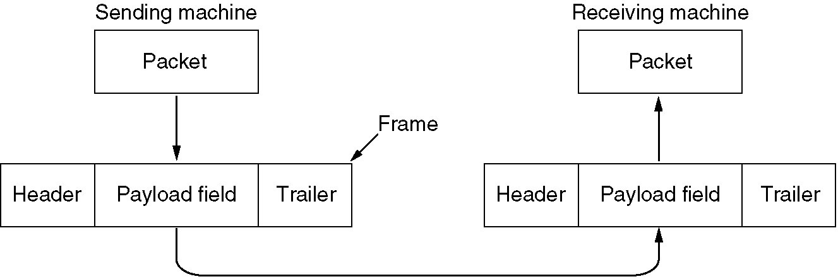
Functions of the Data Link Layer (2)
Relationship between packets and frames.

Slide 75
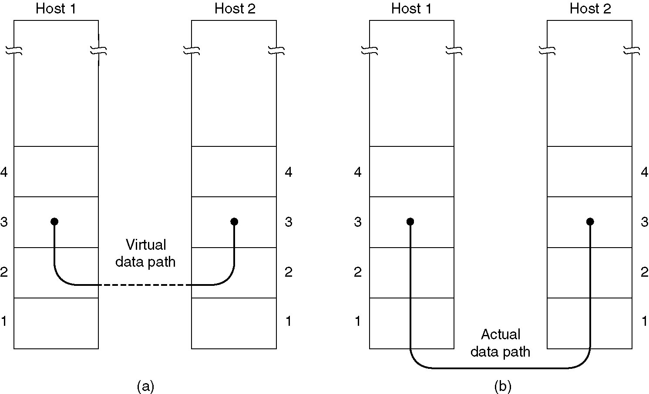
Services Provided to Network Layer
(a) Virtual communication.
(b) Actual communication.

Slide 76
DLL Design
SERVICES PROVIDED TO THE NETWORK LAYER
Delivery Mechanisms:
UN-Acknowledged
Acknowledged
Connection-Less
“Best Effort”
Better Quality
Connection
Oriented
Reliable Delivery

Slide 77
DLL Design
Unacknowledged connectionless service لايوجد ربط قبل ارسال المعلومات
No flow- and error-control mechanisms
Data delivery not guaranteed
Best Effort
Acknowledged connectionless service
Cross between previous two
Sent data is acknowledged
No prior logical setup (لايوجد ربط قبل أرسال المعلومات)
Better Quality
Connection-mode service
Logical connection set up between two users يحتاج الى ربط قبل أرسال المعلومات
Flow- and error-control provided
Reliable Delivery

Slide 78
DLL Design
SERVICES PROVIDED TO THE NETWORK LAYER
Unacknowledged Connection-less Service -- Best Effort:
The receiver does not return acknowledgments to the sender, so the sender has no way of knowing if a frame has been successfully delivered.
When would such a service be appropriate?
Acknowledged Connection-less Service -- Acknowledged Delivery:
The receiver returns an acknowledgment frame to the sender indicating that a data frame was properly received. The sender keeps connection state, but may not necessarily retransmit unacknowledged frames.
Acknowledged Connection-Oriented Service -- Reliable Delivery:
Frames are delivered to the receiver reliably and in the same order as generated by the sender.

Slide 79
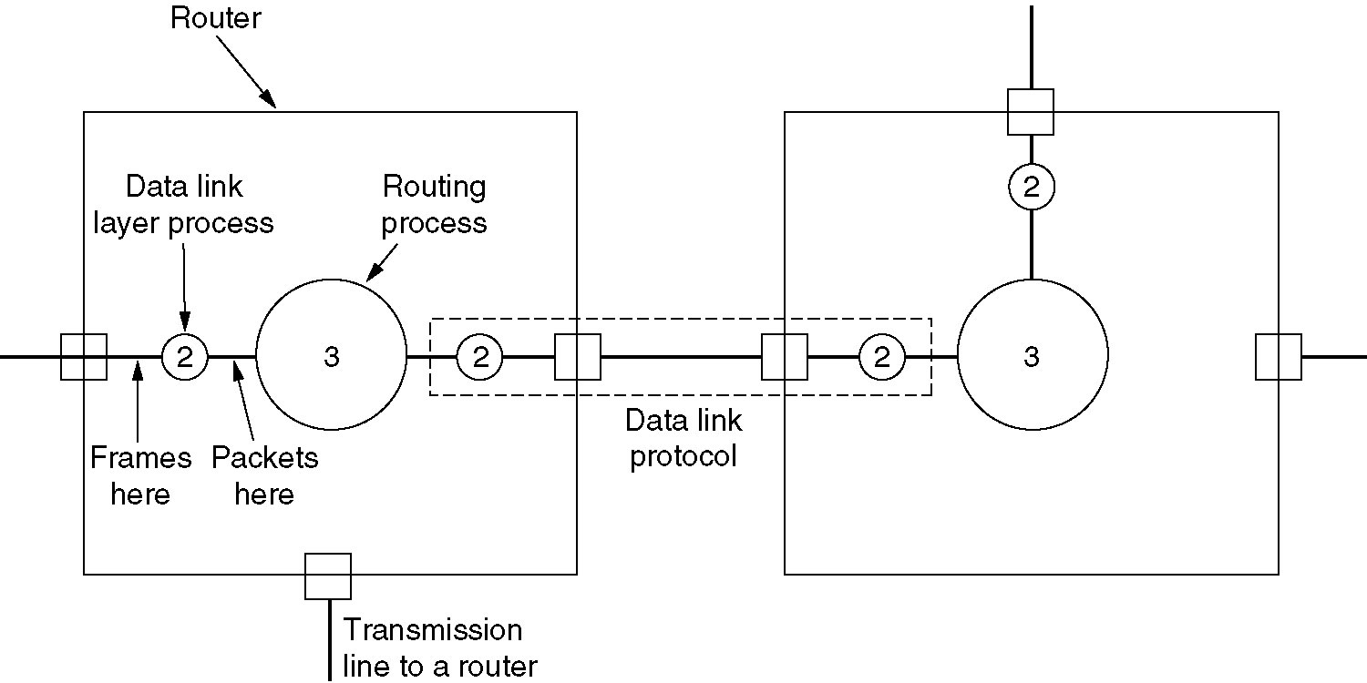
Services Provided to Network Layer (2)
Placement of the data link protocol.

Slide 80
DLL Design
FRAMING
The DLL translates the physical layer's raw bit stream into frames. How can frame be transmitted so the receiver can detect frame boundaries? That is, how can the receiver recognize the start and end of a frame? We need synchronization . Now, we will discuss four ways:
Character Count:
Character stuffing:
Bit Stuffing:
Encoding Violations:

Slide 81
DLL Design
FRAMING
Character Count:
Make the first field in the frame's header be the length of the frame. That way the receiver knows how big the current frame is and can determine where the next frame ends.
Disadvantage: Receiver loses synchronization when bits become garbled. If the bits in the count become corrupted during transmission, the receiver will think that the frame contains fewer (or more) bits than it actually does.
Although checksum will detect the frames are incorrect, the receiver will have difficulty re-synchronizing to the start of a new frame. This technique is not used anymore, since better techniques are available.

Slide 82
Framing
A character stream. (a) Without errors. (b) With one error.

Slide 83
DLL Design
FRAMING
Character stuffing:
Same idea as bit-stuffing, but operates on bytes instead of bits.
Use reserved characters to indicate the start and end of a frame. For instance,
use the two-character sequence DLE STX (Data-Link Escape, Start of TeXt) to indicate the beginning of a frame, and the sequence DLE ETX (End of TeXt) to indicate the end of a frame.
Problem: What happens if the two-character sequence DLE ETX happens to appear in the frame itself?
Solution: Use character stuffing within the frame, replace every occurrence of DLE with the two-character sequence DLE DLE. The receiver reverses the process, replacing every occurrence of DLE DLE with a single DLE.
Example: If the frame contained
“ A B DLE D E DLE", the characters transmitted would be
"DLE STX A B DLE DLE D E DLE DLE DLE ETX".
Disadvantage: A octet is the smallest unit that can be operated on; not all architectures are 8-bit oriented.

Slide 84
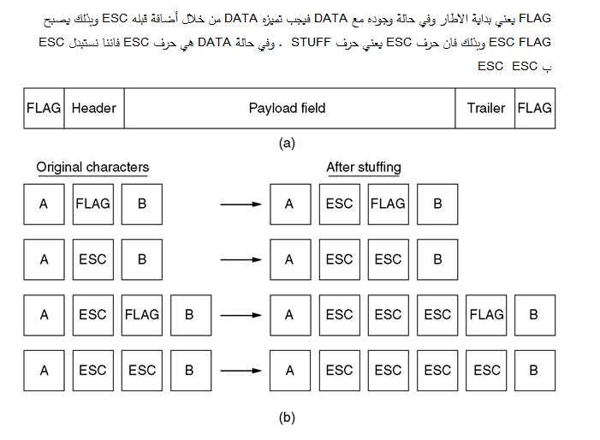
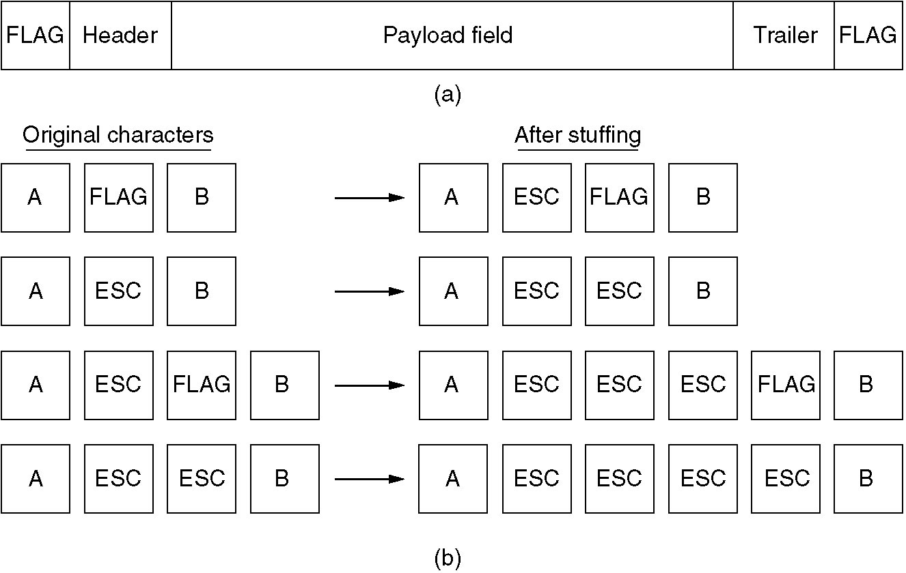
Framing (2)
(a) A frame delimited by flag bytes.
(b) Four examples of byte sequences before and after stuffing.

Slide 85
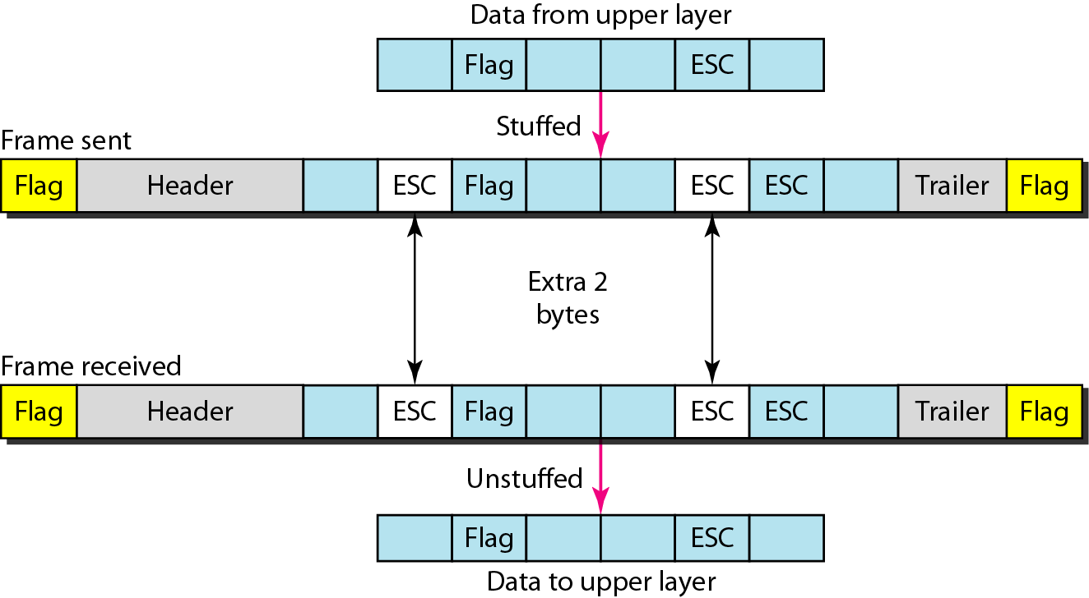
Figure 11.2 Byte stuffing and unstuffing

Slide 86
Note
Byte stuffing is the process of adding 1 extra byte whenever there is a flag or escape character in the text.

Slide 87
DLL Design
FRAMING
Bit Stuffing:
IDEA: Use reserved bit patterns to indicate the start and end of a frame. For instance, use the 4-bit sequence of 0111 to delimit consecutive frames. A frame consists of everything between two delimiters.
Problem: What happens if the reserved delimiter happens to appear in the frame itself? If we don't remove it from the data, the receiver will think that the incoming frame is actually two smaller frames!
Solution: Use bit stuffing. Within the frame, replace every occurrence of two consecutive 1's with 110. E.g., append a zero bit after each pair of 1's in the data. This prevents 3 consecutive 1's from ever appearing in the frame.

Slide 88
DLL Design
FRAMING
Bit Stuffing:
The receiver converts two consecutive 1's followed by a 0 into two 1's, but recognizes the 0111 sequence as the end of the frame.
Example: The frame "1 0 1 1 1 0 1" would be transmitted over the physical layer as "0 1 1 1 1 0 1 1 0 1 0 1 0 1 1 1".
Note: When using bit stuffing, locating the start/end of a frame is easy, even when frames are damaged. The receiver simply scans arriving data for the reserved patterns.
The receiver will re-synchronize quickly with the sender as to where frames begin and end, even when bits in the frame get garbled.
The main disadvantage with bit stuffing is the insertion of additional bits into the data stream, wasting bandwidth. How much expansion? The precise amount depends on the frequency in which the reserved patterns appear as user data.

Slide 89
Bit-Oriented Protocols
In a bit-oriented protocol, the data section of a frame is a sequence of bits to be interpreted by the upper layer as text, graphic, audio, video, and so on.
However, in addition to headers (and possible trailers), we still need a delimiter to separate one frame from the other.
Most protocols use a special 8-bit pattern flag 01111110 as the delimiter to
define the beginning and the end of the frame.

Slide 90
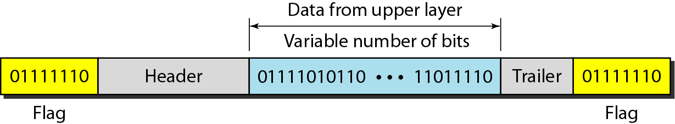
Figure 11.3 A frame in a bit-oriented protocol

Slide 91
This flag can create the same type of problem we saw in the byte-oriented protocols.
That is, if the flag pattern appears in the data, we need to somehow inform the receiver that this is not the end of the frame.
We do this by stuffing 1 single bit (instead of I byte) to prevent the pattern from looking like a flag.
The strategy is called bit stuffing.
In bit stuffing, if a 0 and five consecutive I bits are encountered, an extra 0 is added.
This extra stuffed bit is eventually removed from the data by the receiver.
Note that the extra bit is added after one 0 followed by five 1s regardless of the value of the next bit.
This guarantees that the flag field sequence does not inadvertently appear in the frame.

Slide 92
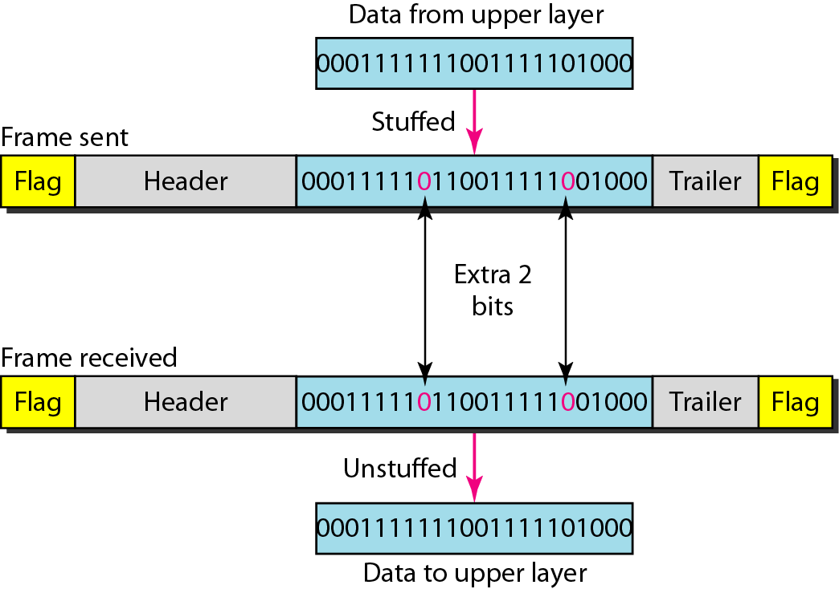
Figure 11.4 Bit stuffing and unstuffing
Figure 11.4 shows bit stuffing at the sender and bit removal at the receiver. Note that even if we have a 0 after five 1s, we still stuff a O. The 0 will be removed by the receiver.
This means that if the flag like pattern 01111110 appears in the data, it will change to 011111010 (stuffed) and is not mistaken as a flag by the receiver. The real flag 01111110 is not stuffed by the sender and is recognized by the receiver.

Slide 93
Note
Bit stuffing is the process of adding one extra 0 whenever five consecutive 1s follow a 0 in the data, so that the receiver does not mistake
the pattern 0111110 for a flag.

Slide 94
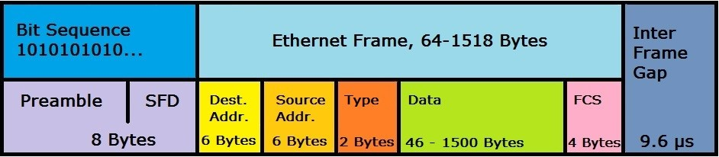
DLL Design
FRAMING
Encoding Violations:
Send a signal (start and End) that doesn't conform to any legal bit representation. In Manchester encoding, for instance, logic 1-bits are represented by a (high-low) sequence, and logic 0-bits by (low-high) sequences. The start/end of a frame could be represented by (low-low) or (high-high).
The advantage of encoding violations is that no extra bandwidth is required as in bit or character stuffing. The IEEE 802.4 standard uses this approach.
Finally, some systems use a combination of these techniques. IEEE 802.3, for instance, has both a length field and special frame start and frame end patterns.

Slide 95
The Data Link Layer
Chapter 3

Slide 96
Error Control 1-Error Correction and 2- Error Detection
Error-Correcting Codes
Using Hamming Distance Algorithm
For Simplex (one Direction)Networks
2. Error-Detecting Codes
Using Cyclic Redundancy Check (CRC) Algorithm &
Parity Check Algorithm
For (Two Directions) Full-Duplex and Half Duplex Networks

Slide 97
DLL Design
ERROR CONTROL
Must insure that all frames are eventually delivered (possibly in order) to a destination. Three components are required to do this:
1- Acknowledgments, 2- Timers, and 3- Sequence Numbers
Acknowledgments:
Reliable delivery is achieved using the "acknowledgments with retransmission" paradigm.
The receiver returns a special acknowledgment (ACK) frame to the sender indicating the correct receipt of a frame.
In some systems, the receiver also returns a negative acknowledgment (NACK) for incorrectly-received frames.
This is only a hint to the sender so that it can retransmit a frame right away without waiting for a timer to expire.

Slide 98
DLL Design
ERROR CONTROL
Timers:
One problem that simple ACK/NACK schemes fail to address is recovering from a frame that is lost, and as a result, fails to solicit an ACK or NACK.
What happens if an ACK or NACK becomes lost?
Retransmission timers are used to resend frames that don't produce an ACK. When sending a frame, schedule a timer to expire at some time after the ACK should have been returned. If the timer goes off, retransmit the frame.
Sequence Numbers:
Retransmissions introduce the possibility of duplicate frames.
To suppress duplicates, add sequence numbers to each frame, so that a receiver can distinguish between new frames and repeats of old frames.
Bits used for sequence numbers depend on the number of frames that can be outstanding at any one time.

Slide 99
DLL Design
FLOW CONTROL
Flow control deals with throttling the speed of the sender to match that of the receiver. Usually, this is a dynamic process, as the receiving speed depends on such changing factors as the load, and availability of buffer space.
One solution is to have the receiver extend credits to the sender. For each credit, the sender may send one frame. Thus, the receiver controls the transmission rate by handing out credits.
LINK INITIALIZATION:
In some cases, the data link layer service must be "opened" before use:
The data link layer uses open operations for allocating buffer space, control blocks, agreeing on the maximum message size, etc.
Synchronize and initialize send and receive sequence numbers with its peer at the other end of the communications channel.

Slide 100
Error Detection & Control
ERROR CORRECTING CODES
In data communication, line noise is a fact of life (e.g., signal attenuation, natural phenomenon such as lightning, and the telephone worker). Moreover, noise usually occurs as bursts rather than independent, single bit errors. For example, a burst of lightning will affect a set of bits for a short time after the lightning strike.
Detecting and correcting errors requires redundancy - sending additional information along with the data.
There are two types of attacks against errors:
Error Detecting Codes: Include enough redundancy bits to detect errors and use ACKs and retransmissions to recover from the errors.
Error Correcting Codes: Include enough redundancy to detect and correct errors.
We will introduce some concepts, and then consider both detection and correction.
To understand errors, consider the following:
Messages (frames) consist of m data (message) bits and r redundancy bits, yielding an n = ( m + r ) bit codeword

Slide 101
Error Detection & Control
ERROR CORRECTING CODES
Hamming Distance. Given any two codewords, we can determine how many of the bits differ. Simply exclusive or (XOR) the two words, and count the number of 1 bits in the result. This count is the Hamming Distance.
Significance? If two codewords are d bits apart, d errors are required to convert one to the other.
A code's Hamming Distance is defined as the minimum Hamming Distance between any two of its legal codewords (from all possible codewords).
In general, all 2^{m} possible data words are legal. However, by choosing check bits carefully, the resulting codewords will have a large Hamming Distance. The larger the Hamming distance, the better the codes are able to detect errors.
To detect d 1-bit errors requires having a Hamming Distance of at least d + 1 bits. Why?
To correct d errors requires 2d + 1 bits. Intuitively, after d errors, the garbled messages is still closer to the original message than any other legal codeword.

Slide 102
Error Detection & Control
ERROR CORRECTING CODES
Parity Bits
A single parity bit is appended to each data block (e.g. each character in ASCII systems) so that the number of 1 bits always adds up to an even (odd) number.
1000000(1) 1111101(0)
The Hamming Distance for parity is 2, and it cannot correct even single-bit errors (but can detect single-bit errors). As another example, consider a 10-bit code used to represent 4 possible values:
"00000 00000", "00000 11111", "11111 00000", and "11111 11111".
Its Hamming distance is 5, and we can correct 2 single-bit errors:
For instance, "10111 00010" becomes "11111 00000" by changing only two bits.
However, if the sender transmits "11111 00000" and the receiver sees "00011 00000", the receiver will not correct the error properly.
Finally, in this example we are guaranteed to catch all 2-bit errors, but we might do better: if "00111 00111" contains 4 single-bit errors, we will reconstruct the block correctly.

Slide 103
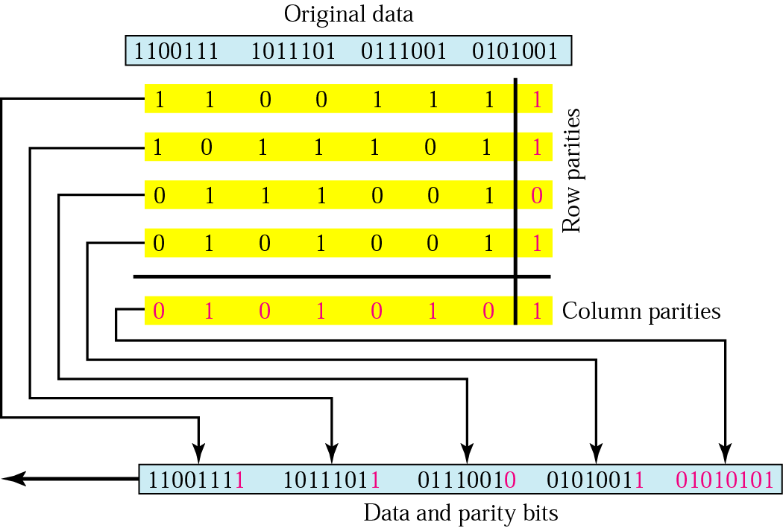
Two-dimensional parity

Slide 104
Error Detection & Control
ERROR CORRECTION
What's the fewest number of bits needed to correct single bit errors? Let us design a code containing n = m + r bits that corrects all single-bit errors (remember m is the number of message (data) bits and r is number of redundant (check) bits):
There are 2^{m} legal messages (e.g., legal bit patterns).
Each of the m messages has n illegal codewords a distance of 1 from it. That is, if we systematically invert each bit in the corresponding n-bit codeword, we get illegal codewords a distance of 1 from the original. Thus, each message requires n + 1 bits dedicated to it (n that are one bit away and 1 that is the message).
The total number of bit patterns is ( n + 1 ) * 2^{m} < 2^{n}. That is, all (n+1) * 2^{m} encoded messages should be unique, and there can't be fewer messages than the 2^{n} possible code-words.
Since n = m + r , we get:
( m + r + 1) * 2^{m} < 2^{m+r} or
( m + r + 1) < 2^{r}
This formula gives the absolute lower limit on the number of bits required to detect (and correct!) 1-bit errors.

Slide 105
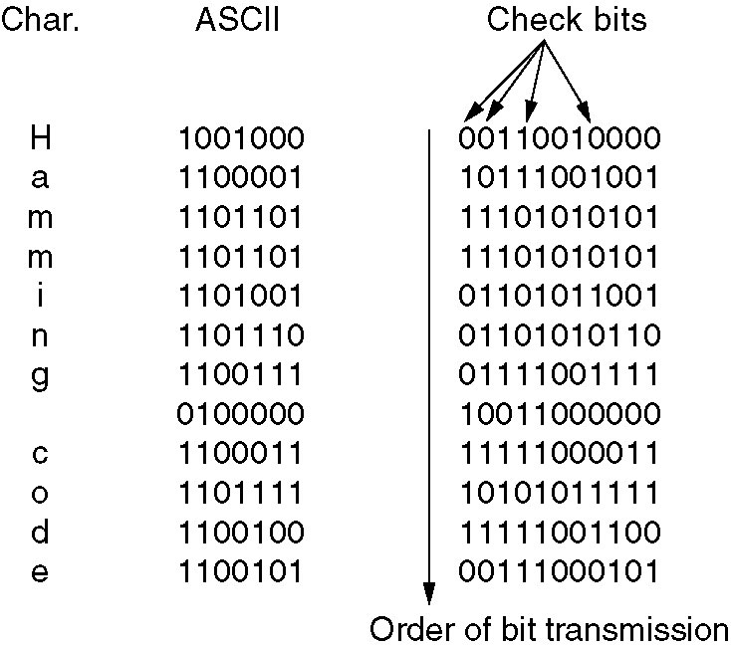
Error-Correcting Codes
Use of a Hamming code to correct burst errors.

Slide 106
Hamming Code

Slide 107
Data and redundancy bits
Number of data bits m | Number of redundancy bits r | Total bits m + r
1 | 2 | 3
2 | 3 | 5
3 | 3 | 6
4 | 3 | 7
5 | 4 | 9
6 | 4 | 10
7 | 4 | 11

Slide 108
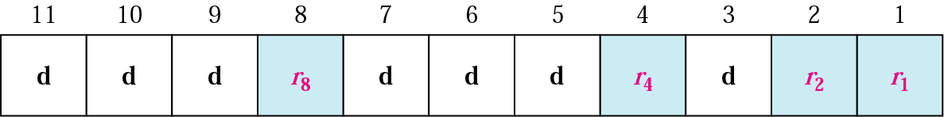
Positions of redundancy bits in Hamming code

Slide 109
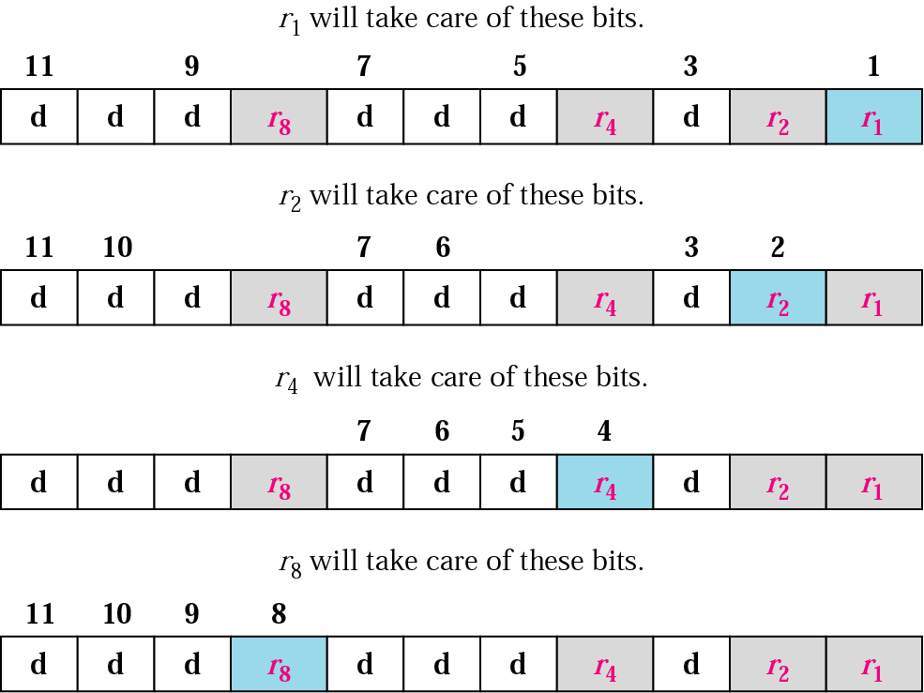
Redundancy bits calculation

Slide 110
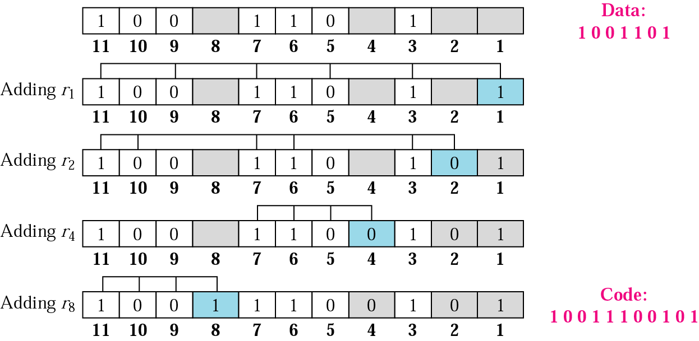
Example of redundancy bit calculation

Slide 111
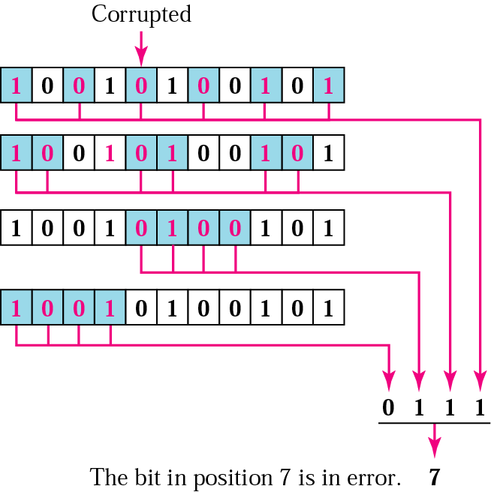
Error detection using Hamming code

Slide 112
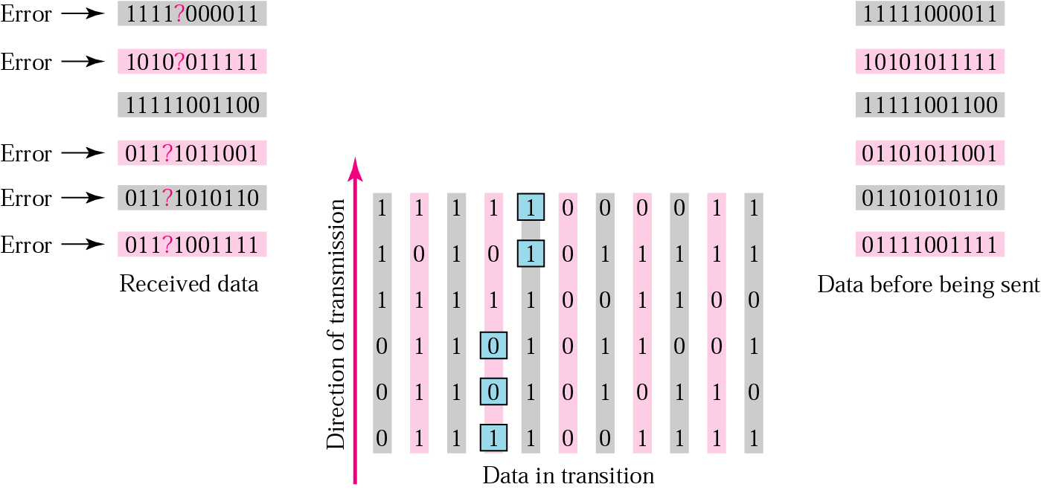
Burst error correction example

Slide 113
Error Detection & Control
ERROR DETECTION
Error correction is relatively expensive (computationally and in bandwidth.)
For example, 10 redundancy bits are required to correct 1 single-bit error in a 1000-bit message. In contrast, detecting a single bit error requires only a single-bit, no matter how large the message. The most popular error detection codes are based on polynomial codes or cyclic redundancy codes(CRCs).
Allows us to acknowledge correctly received frames and to discard incorrect ones.
Tanenbaum and you have worked several examples.

Slide 114
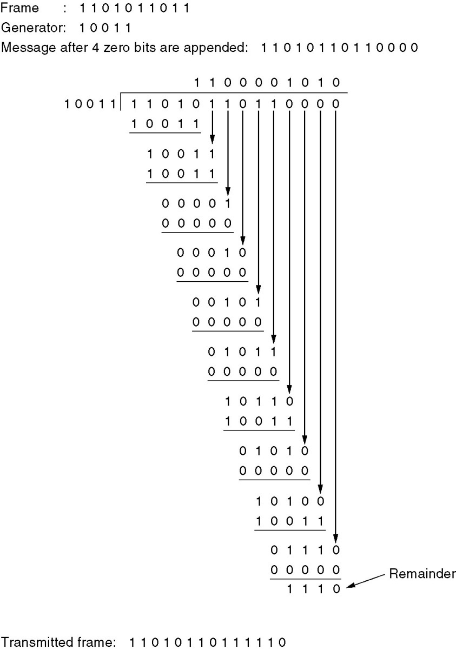
Error-Detecting Codes
Calculation of the polynomial code checksum.

